Slide 1
Biology
Unit 7: Genetics and Heredity
Lesson 3: Traits and Probability
Notes:
Lesson Objective:
To construct explanations about how traits are passed from parents to offspring.

Slide 2

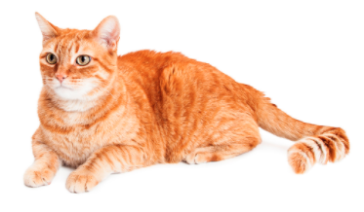
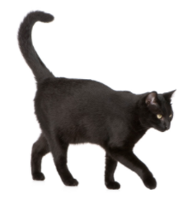
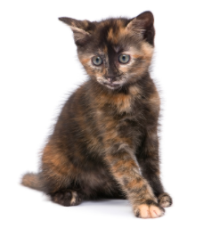
Can You Explain It?
Unit 7 Lesson 3
What can you determine from the fact that only male kittens inherited the mother's phenotype?

Slide 3
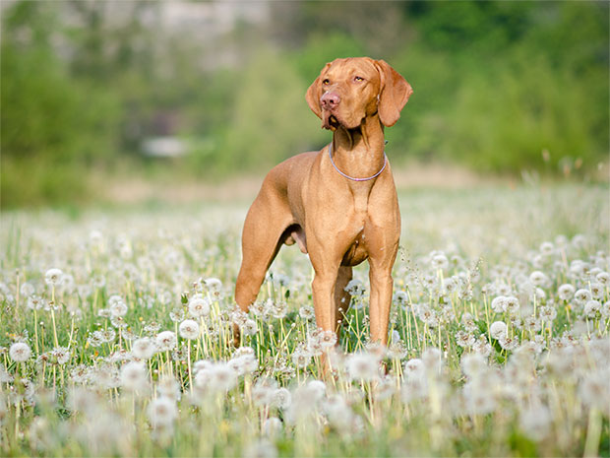
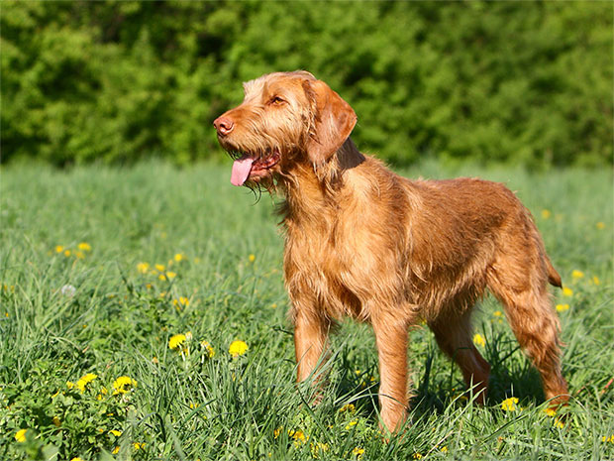
Predicting Generations
Unit 7 Lesson 3
Coat texture in dogs is a heritable characteristic. Some dogs, like the vizsla, can have a smooth coat or a wiry coat, and this trait is controlled by one gene.
The wire-coated allele is dominant, noted as W, and the smooth-coated allele is recessive, noted as w.

Slide 4
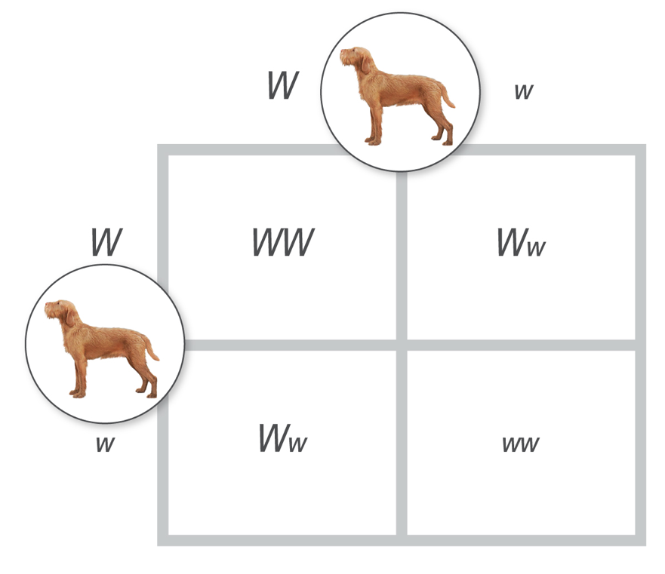
Predicting Generations
Unit 7 Lesson 3
A simple table, now known as a Punnett square, predicts all possible offspring genotypes resulting from a specific cross.
The completed Punnett square shows three possible genotypes for coat type: homozygous dominant (WW), heterozygous (Ww), or homozygous recessive (ww).

Slide 5
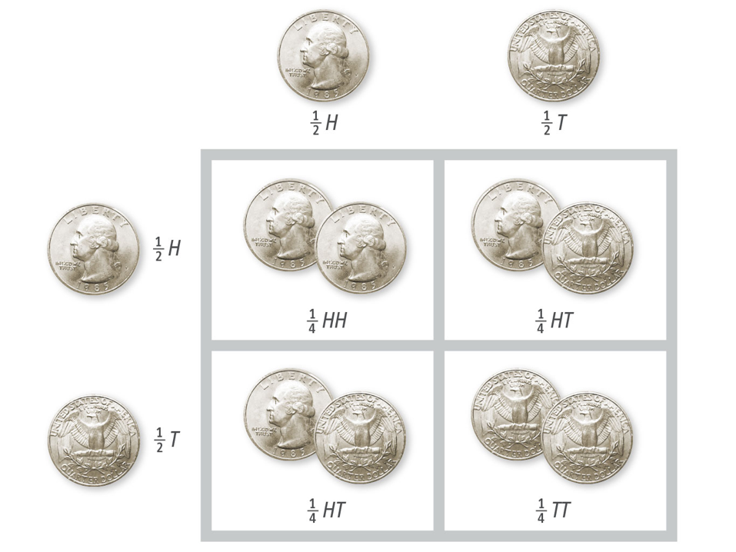
Predicting Generations
Unit 7 Lesson 3
Probability is the chance that an outcome will occur, such as the birth of a dog with a wire coat.

Slide 6
Predicting Generations
Unit 7 Lesson 3
EXPLAIN
How can a Punnett square help you explain the phenotypes of the kittens discussed at the beginning of this lesson? Use your knowledge of meiosis to help support your answer.

Slide 7
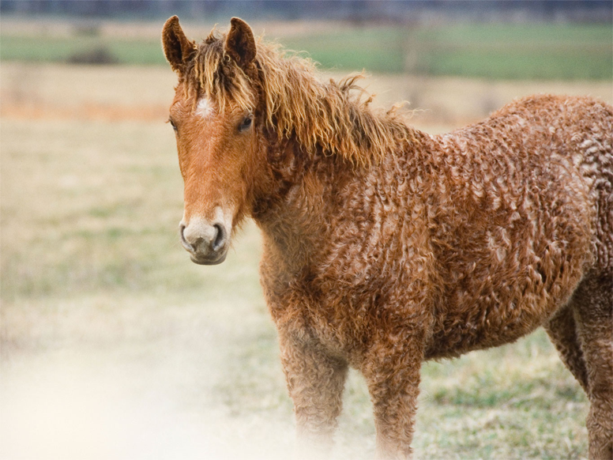
Determining Types of Crosses
Unit 7 Lesson 3
Imagine you crossed a smooth-haired Bashkir horse with a curly-haired Bashkir horse. How could you determine the possible outcomes of this cross?

Slide 8
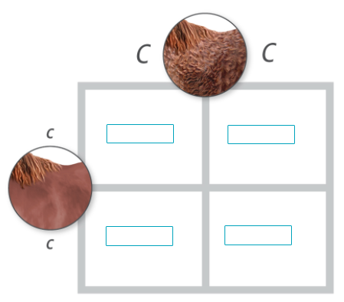
Determining Types of Crosses
Unit 7 Lesson 3
A cross that examines one trait is a monohybrid cross.
There are three basic types of monohybrid crosses: a homozygous-homozygous cross, a heterozygous-heterozygous cross, and a heterozygous-homozygous cross.

Slide 9

Determining Types of Crosses Hands-On Labs: Determining a Genotype
Unit 7 Lesson 3
Imagine your company sells peach and nectarine seedlings. You developed a new type of peach tree that is very popular. To meet demand, you must learn the genotypes of your breeding stock.
You determine them by setting up a testcross between an individual that has a dominant phenotype but an unknown genotype and an individual that is homozygous recessive.

Slide 10
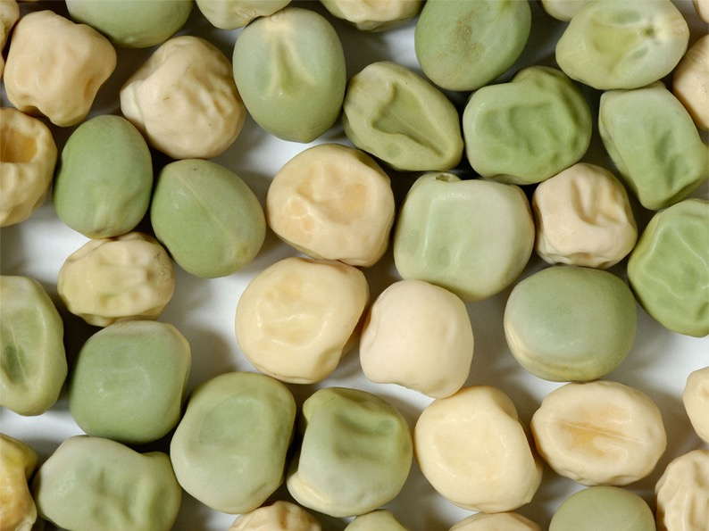
Determining Types of Crosses
Unit 7 Lesson 3
A dihybrid cross examines the inheritance of two different traits, such as Mendel's observations of pea color and shape in his plants.

Slide 11
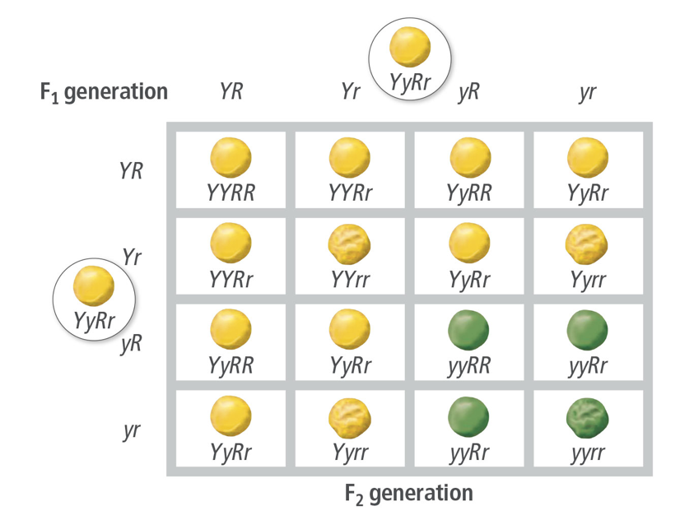
Determining Types of Crosses
Unit 7 Lesson 3
Determine the number of possible phenotypes in the dihybrid cross. What is the ratio for all the possibilities?

Slide 12
Determining Types of Crosses
Unit 7 Lesson 3
EXPLAIN
Why are Punnett squares a useful model for scientists studying traits and genetic disorders? In which other types of careers would this model be useful?

Slide 13
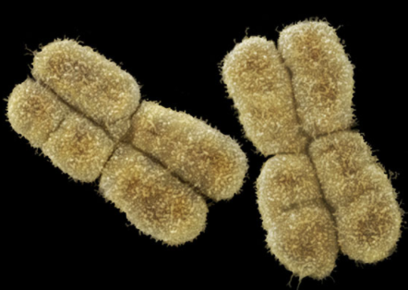
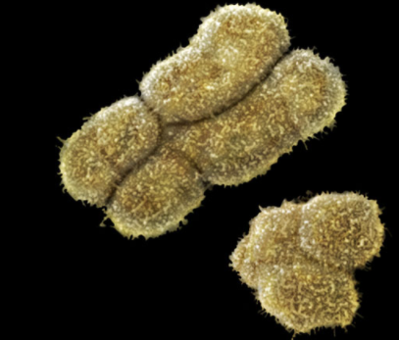
Sex-Linked Inheritance
Unit 7 Lesson 3
Human offspring have an equal probability of being male (XY) or female (XX).
The mother donates an X chromosome, so the chromosome donated by the father is the one that determines the sex of the offspring.
Genes located on sex chromosomes are sex-linked genes.

Slide 14
Sex-Linked Inheritance Hands-On Activity: Sex-Linked Inheritance
Unit 7 Lesson 3
What genotypes result in normal vision and which result in color blindness?

Slide 15
Sex-Linked Inheritance
Unit 7 Lesson 3
EXPLAIN
How do the genotypic and phenotypic ratios of the sex-linked trait differ from the monohybrid cross?

Slide 16
Unit 7 Lesson 3
Continue Your Exploration
Choose one of the paths below to continue your exploration:
Pedigrees
Modeling Monohybrid and Dihybrid Crosses
Practicing Genetic Crosses
Animal Breeding

Slide 17
Can You Explain It?
Unit 7 Lesson 3
Refer to the notes in your Evidence Notebook to answer the following questions:
Why was the litter of kittens not half black and half orange?
Why were there only female tortoiseshell kittens?
Which alleles were passed on by each parent cat in this cross? Which alleles did the male offspring receive? Which alleles did the female offspring receive?

Slide 18
Image Credits
Unit 7 Lesson 3
Arctic fox in field ©BMJ/Shutterstock; Arctic fox in snow ©E+/DmitryND/Getty Images; fruit fly ©Andrew Syred/Science Source; orange tabby cat ©adogslifephoto/Fotolia; black cat ©Eric Isselée/Fotolia; tortoiseshell kitten ©Eric Isselée/Fotolia; Vizsla, long hair ©scarlet61/Fotolia; curly hair horse ©Mark J. Barrett/Alamy; green and yellowpea seeds ©Martin Shields/Alamy; female human chromosomes ©Power and Syred/Science Source; male human chromosomes ©Power and Syred/Science Source; Vizsla, smooth hair ©tmart_foto/Fotolia

